Slide 1
Sales Dataset Analysis – Advanced Excel Project
Name: Shahin Sulaiman m
Date:03.01.2025

Slide 2
Project Overview & Objectives
This project focuses on analyzing a comprehensive Sales Dataset using Excel to extract valuable insights that can aid in making data-driven business decisions. The dataset Includes key metrics such as sales, discounts, revenue, and sales channels.
Analyze sales trends over time.
Identify high-performing products and sales channels.
Determine the impact of returns and discounts.
Create a dynamic dashboard with key metrics.

Slide 3
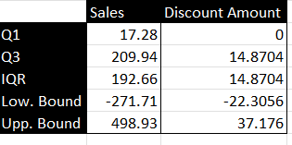
Data Description and Preparation
Dataset Overview:This Dataset has 9995 rows and which contains Order id, Order date, ship date,sales ,discount , quantity,profit.
Data Cleaning Process: Remove Duplicates, Handle Missing Data, Outlier Detection, Data formatting, Data Validation.

Slide 4
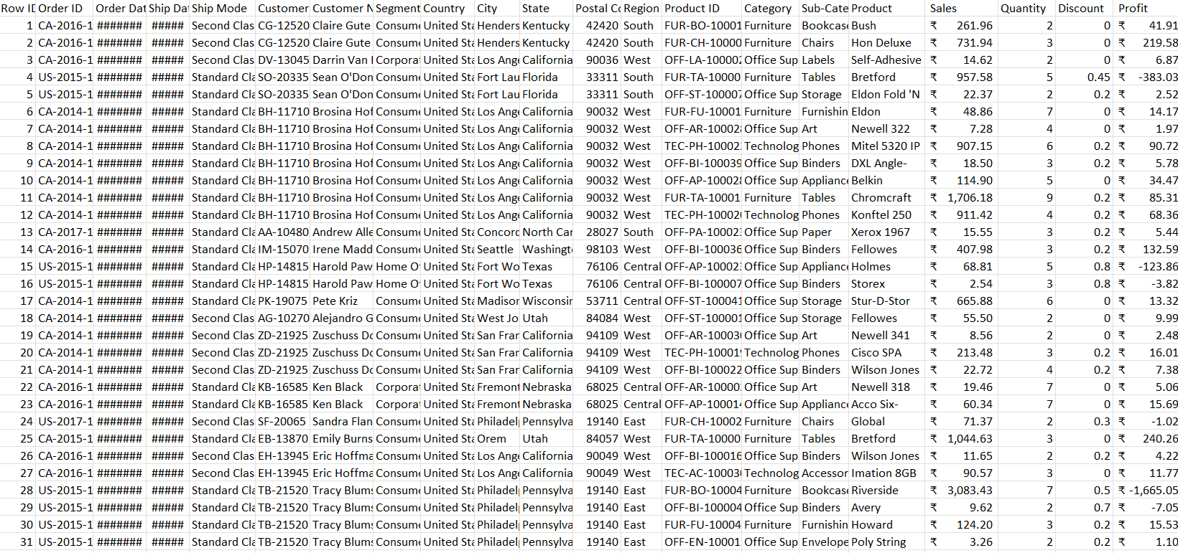
Dataset before cleaning

Slide 5
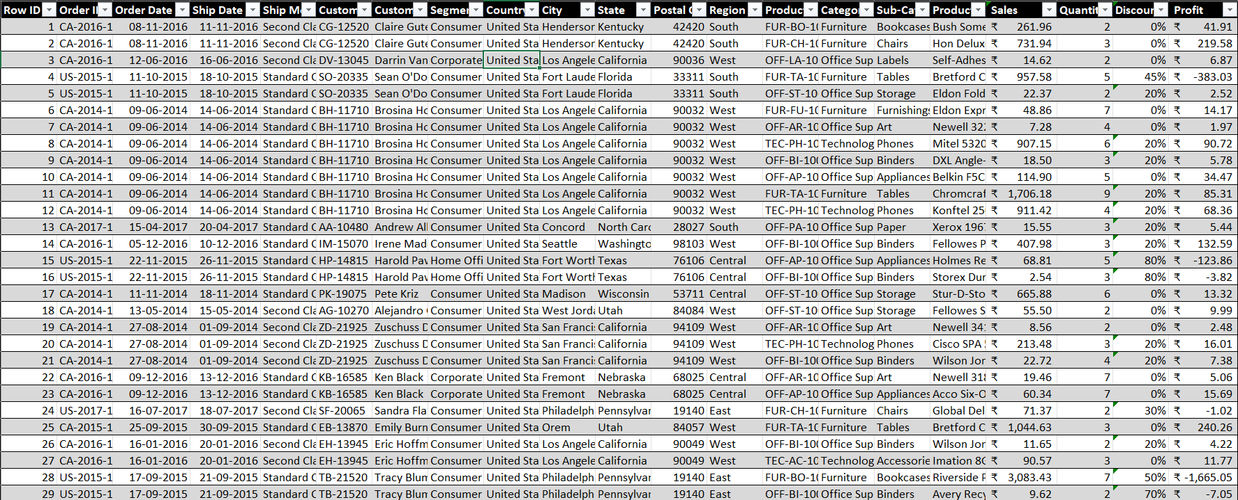
Dataset After Cleaning

Slide 6
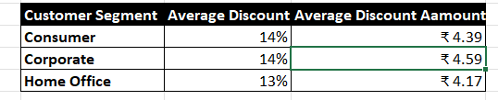
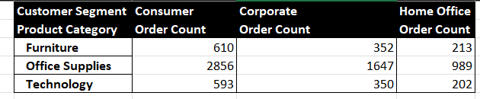
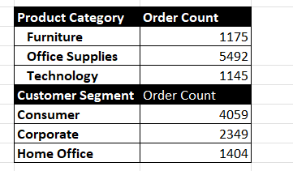
Key Metrics Calculation and Data Analysis
Important Calculations: Total sales (Gross, Net, Adjusted)
Average sales per order
Discount rates, return rates
Sales by channel/product type
Formulas Used:
Averageif
Countif

Slide 7
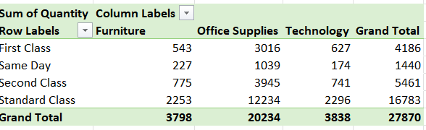
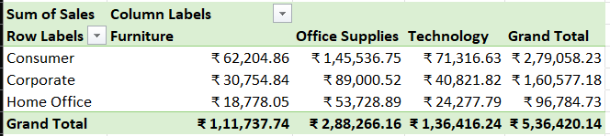
Pivot Tables and Pivot Charts
Sales Channel Aggregation: Aggregated Sales and Discounts by Sales Channel to analyze performance across channels.
Sales Trends Over Time: Used PivotCharts (Line/Column Chart) to visualize Sales Trends by Month or Quarter for time-based analysis.
Product Type Aggregation: Summarized Total Sales by Product Type (e.g., Electronics, Clothing) to evaluate product category performance.

Slide 8
Dashboard overview
Concept of the Dashboard: A Dashboard is a visual interface that aggregates key metrics and data insights into one place, enabling users to easily monitor and analyze business performance in real-time.
Components of the Dashboard:
KPIs: Key Performance Indicators to track business goals.
Charts: Visual representations like Bar, Line, or Pie Charts to display trends and comparisons.
Slicers: Interactive filters that allow users to drill down into specific data segments (e.g., by region, product, or time period).
Purpose: Dashboards make complex data accessible, interactive, and easier to understand, empowering users to make informed decisions quickly

Slide 9
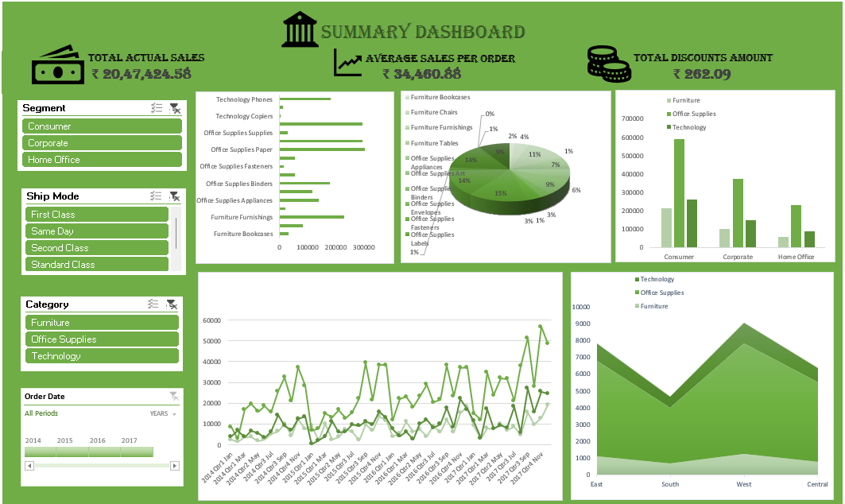
Sales Dashboard

Slide 10
What-If Analysis And goal seek
What-If Analysis is used to explore different scenarios and assess how changes in certain variables affect outcomes.
This process helps in making informed decisions by understanding the potential outcomes of different business strategies and conditions.
Goal Seek is used to determine the necessary input value to achieve a specific target or goal.
This tool is crucial for setting realistic sales targets and forecasting the necessary efforts to achieve business goals.

Slide 11
Macros and Automation
Macro Recording allows you to automate repetitive tasks by recording a sequence of actions and then playing them back with a single command.
Formatting: Used macros to automatically apply consistent formatting to tables and charts (e.g., font size, color, borders).
Time Savings: Macros significantly reduced the time spent on manual data entry, formatting, and calculations by automating these repetitive tasks

Slide 12
Insights and Recommendations
Key Insights:
Best-performing sales channels/products.
Trends in discounting and its impact on total sales.
Seasonal sales variations or peak performance times.
Recommendations for improving sales based on analysis (e.g., reduce returns, increase discounts on underperforming products).

Slide 13
conclusion
Sales Trends: Identification of peak sales periods and underperforming months.
Discount Analysis: Understanding how discount strategies influence Adjusted Sales and profitability.
Sales Channel Performance: Determining which channels contribute most to overall sales and profitability.
Product Insights: Identifying top-performing product categories and areas for improvement.

Slide 14


